Slide 1
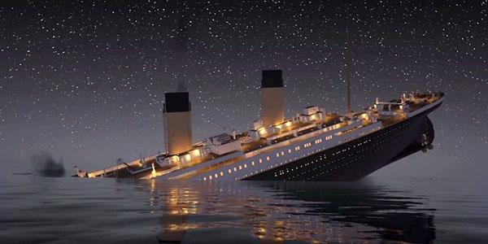
Titanic Data Analysis
Morgan Heller
Assima Imataliyeva
Tram Le
Michael Markin
Evie Nguyen

Slide 2
Introduction
RMS Titanic was a British passenger liner operated by the White Star Line that sank in the North Atlantic Ocean on 15 April 1912 after striking an iceberg.
Of the estimated 2,224 passengers and crew aboard, more than 1,500 died.
Of the 712 survivors 500 were passengers (369 women and children, 131 men) and 212 were crew members (20 women, 192 men)

Slide 3
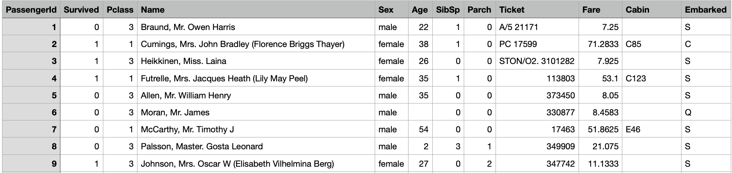
Business Analytics Problem
The decision problem is to analyze the data for 891 passengers of the Titanic to identify which variables and the relationship between the variables are strong and significant.
The dataset provides 12 variables:

Slide 4
Goals and Methods
Our goal is to predict whether a passenger would have survived or not and what factors affected the survival chance the most
The methods used in this project include correlation matrix and regression analysis to examine the relationship between variables and the influence on survival, data analysis with graphing to visualize possible correlation between variables

Slide 5
Data Cleaning
Removed irrelevant columns (PassengerID, Name, etc)
Removed rows with many ‘Age’ values
Filled in missing values in "Embarked" column with "S" (the most common value)
Filled in all the missing Cabin values with 'U' for unknown

Slide 6
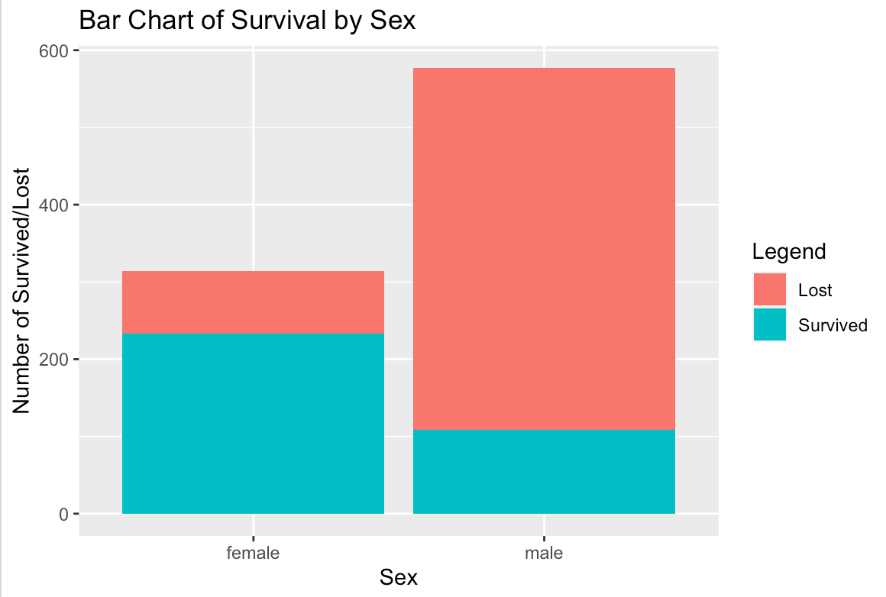
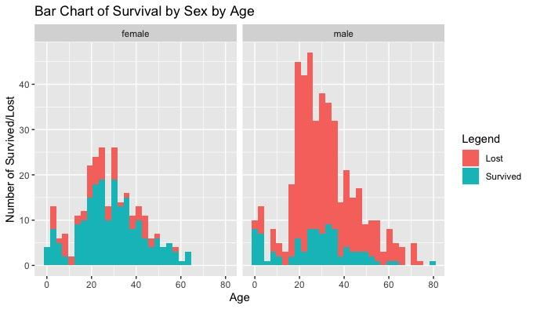
Survival vs Sex, Age

Slide 7
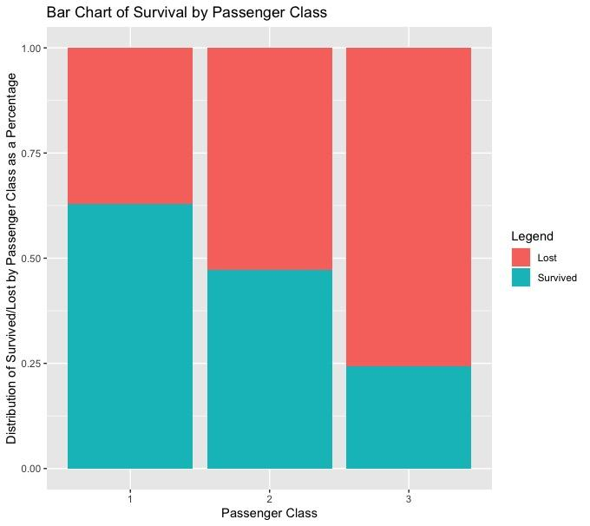
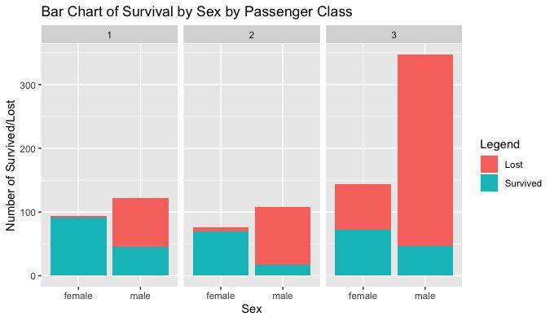
Survival vs Passenger & Class-Sex

Slide 8
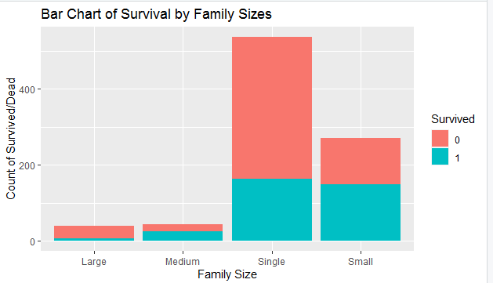
Survival vs Family Size

Slide 9
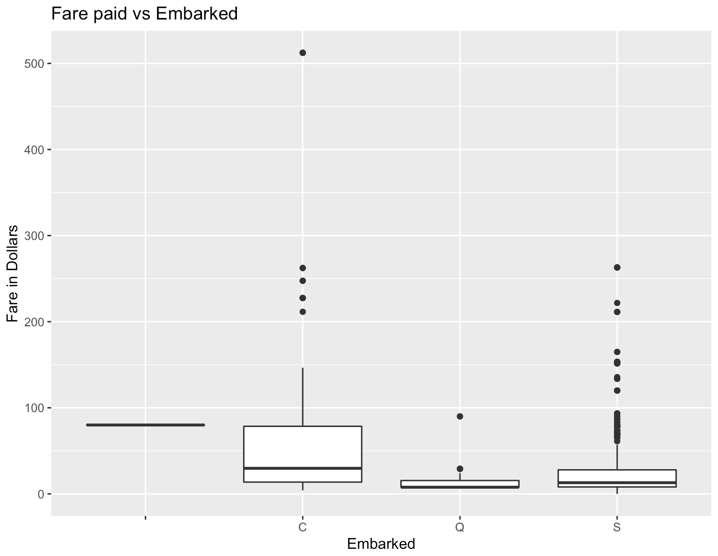
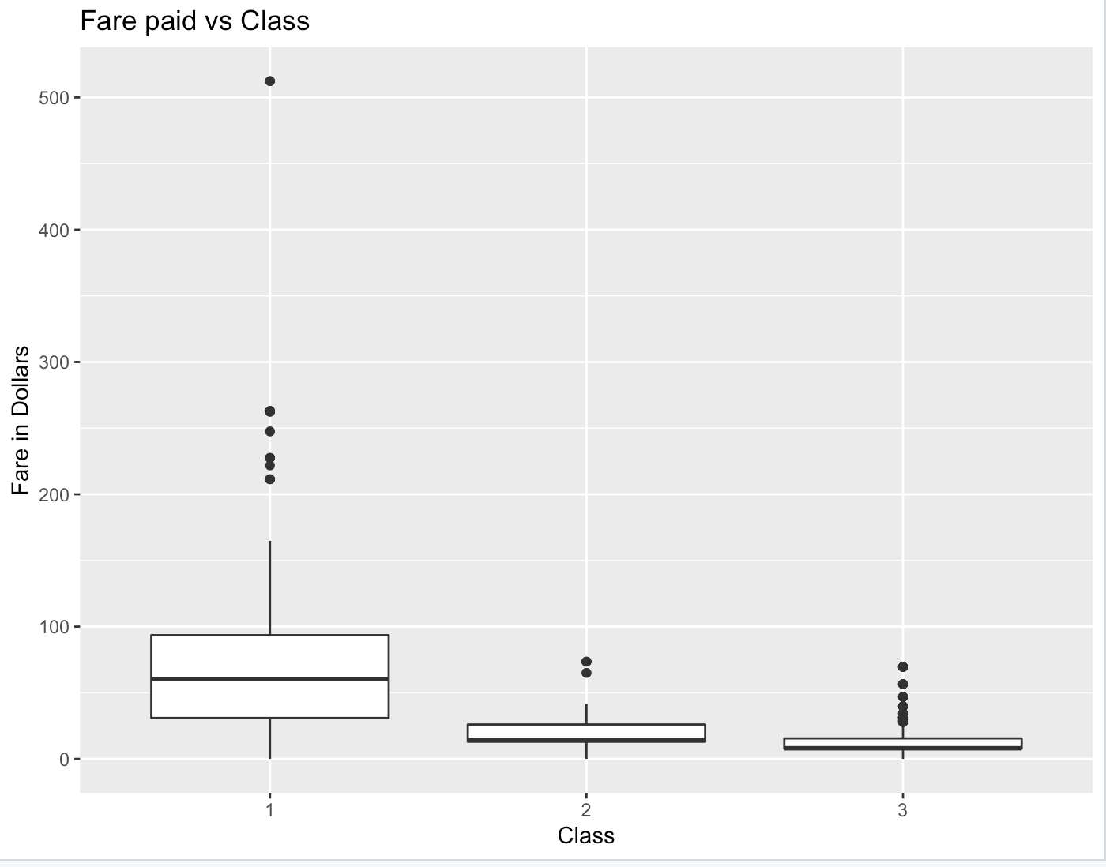
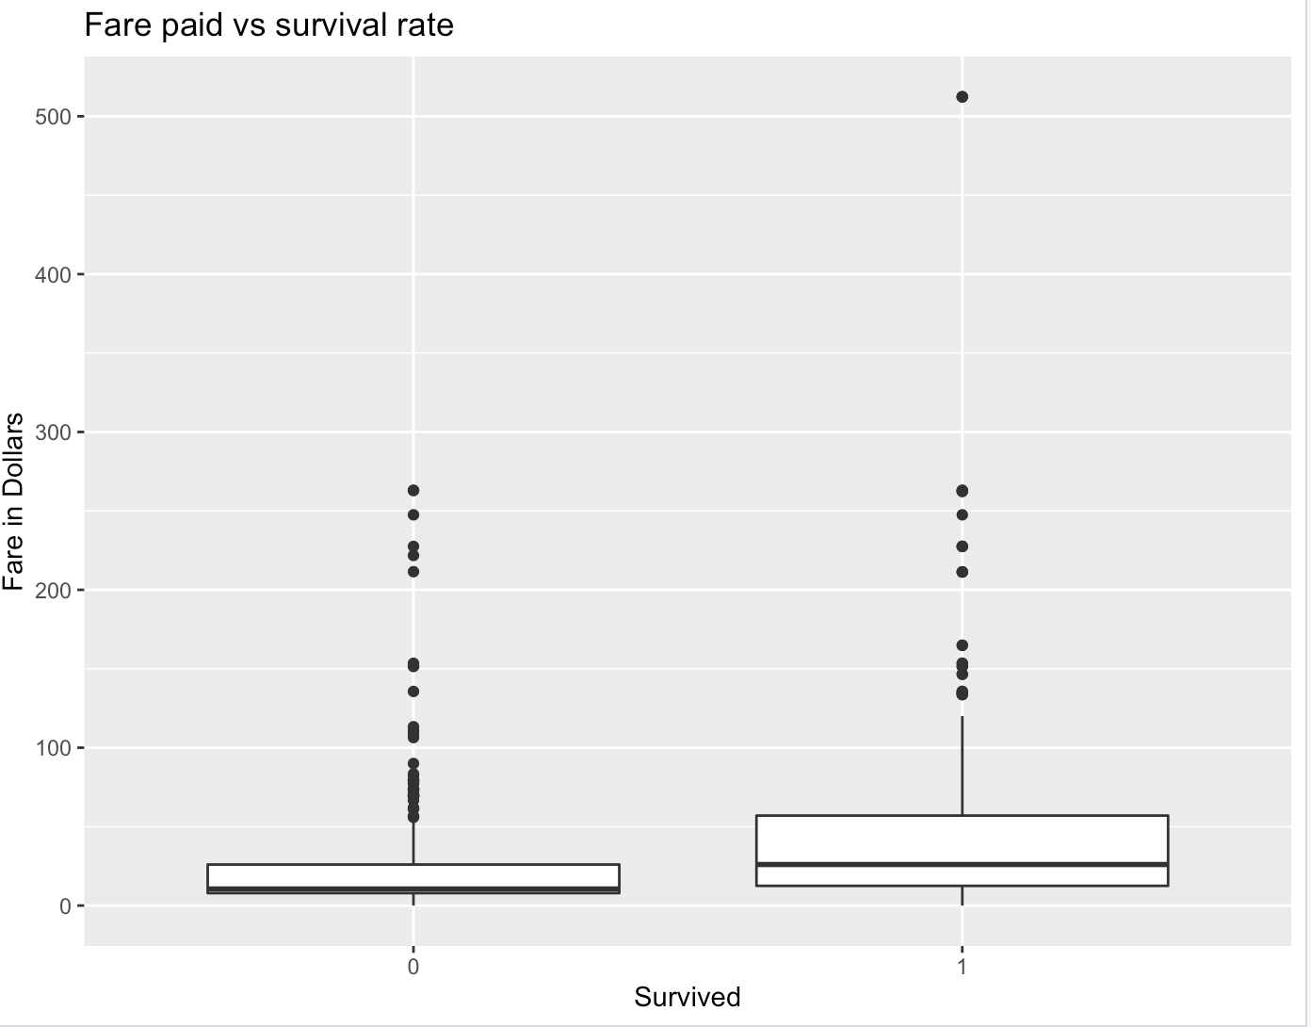
Box Plot-Fare paid

Slide 10
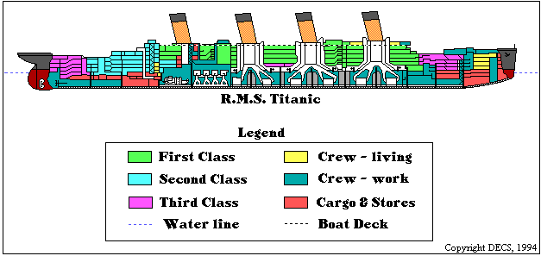
Average Fare by Survived, Class, and Embarked
, , Embarked = NA
Pclass
Survived 1 2 3
0 NA NA NA
1 80 NA NA
, , Embarked = C
Pclass
Survived 1 2 3
0 78.84198 25.41822 9.878361
1 116.12175 25.30510 13.404668
, , Embarked = Q
Pclass
Survived 1 2 3
0 90 12.35 11.65417
1 90 12.35 10.39877
, , Embarked = S
Pclass
Survived 1 2 3
0 57.26093 18.94659 14.52991
1 79.75011 21.92632 15.13146
tapply(titanic$Fare, INDEX = titanic[c("Survived", "Pclass", "Embarked")], FUN=mean)
C = Cherbourg
Q = Queenstown
S = Southampton

Slide 11
Data Iteration
Average survival rate for each segment of class:
tapply(titanic$Survived, titanic$Pclass, FUN = mean)
1 2 3
0.6296296 0.4728261 0.2423625
Average survival rate for each segment of sibsp:
tapply(titanic$Survived, titanic$SibSp, FUN = mean)
0 1 2 3 4 5 8
0.3453947 0.5358852 0.4642857 0.2500000 0.1666667 0.0000000 0.0000000
Average fare grouped by survived:
tapply(titanic$Fare, titanic$Survived, FUN = mean)
0 1
22.11789 48.39541

Slide 12
Correlation matrix
Preliminary transformation:
Remove irrelevant columns (PassengerID, Name, Cabin, Ticket, Embarked)
Omit rows with blank “Age” values.
Transform data types into numeric (for Sex, we label “male” and “female” with 0 and 1)

Slide 13
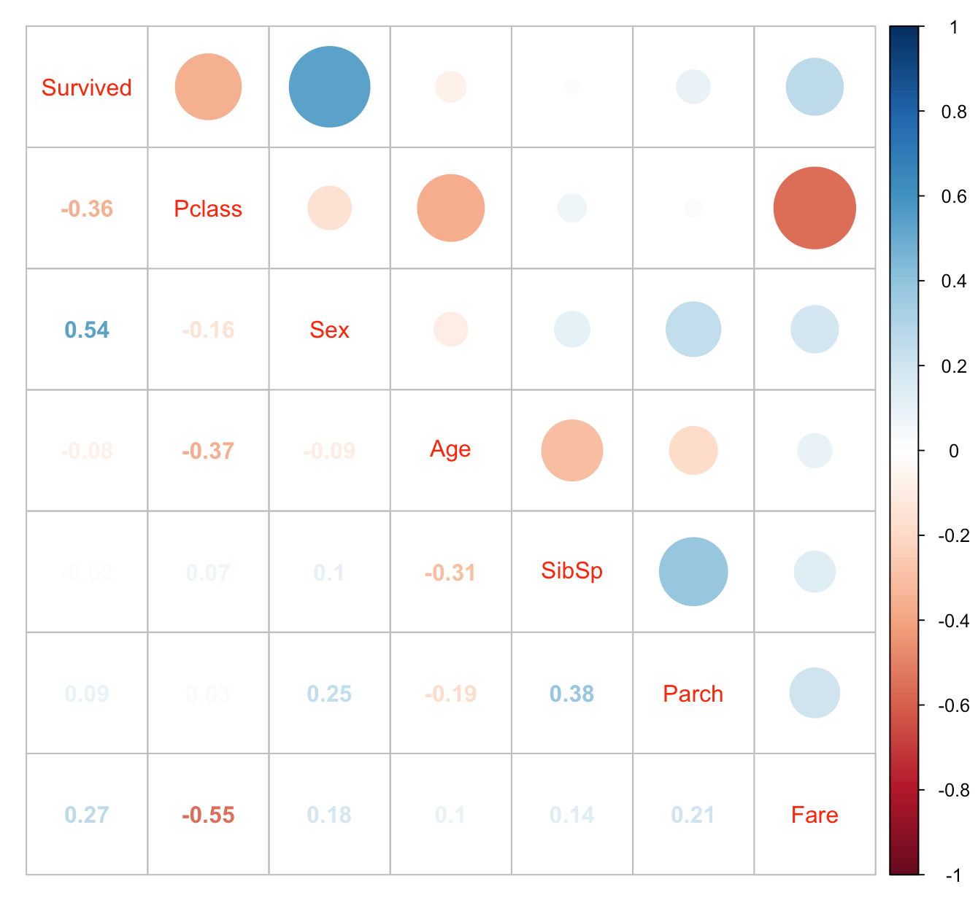
Correlation matrix
From the matrix, we notice that survival rate is:
Positively correlated with Sex and Fare
Negatively correlated with Pclass

Slide 14
Multiple Linear Regression
Purpose: Identify relationships among variables and how they affect survival rate
Preliminary transformation:
Transform the “Fare” and “Age” from characters into numeric variables.
Scale these two variables in order to return an accurate linear regression model.
Transform the categorical variables into factors.
Omit rows with blank “Age” values.

Slide 15
Multiple Linear Regression
Model 1:
Dependent variable: Survived
Independent variables: Pclass + Sex + Age + SibSp + Parch + Fare + Embarked
Model 2:
Optimized from model 1, we will remove insignificant variables and re-run the model
Model 3:
We add interaction variables into the model to understand whether the interaction between each pair of variables is significant

Slide 16
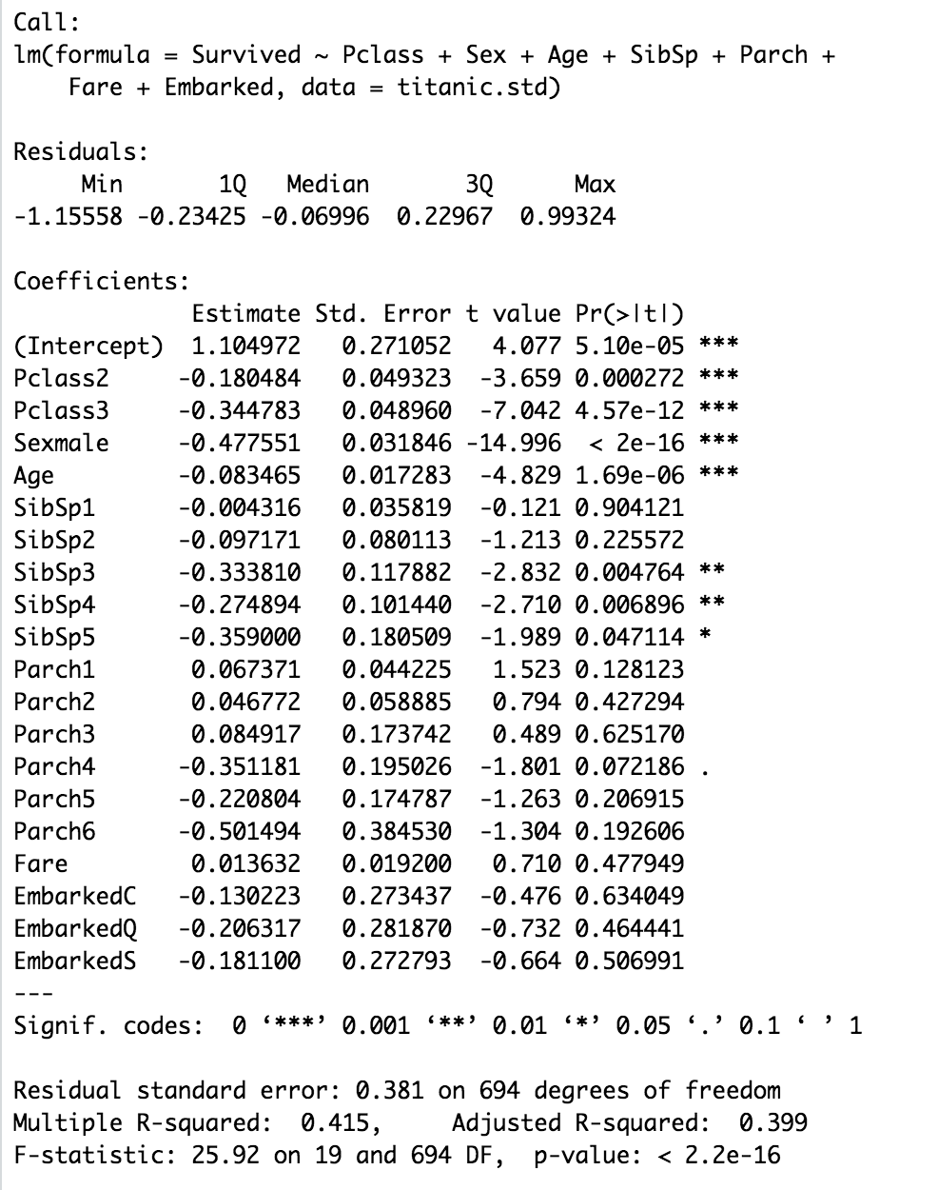
Multiple Linear Regression
Model 1
Adjusted R squared: 0.399
Significant variables:
Pclass
Sex male
Age
SipSp3
SipSp4
SipSp5

Slide 17
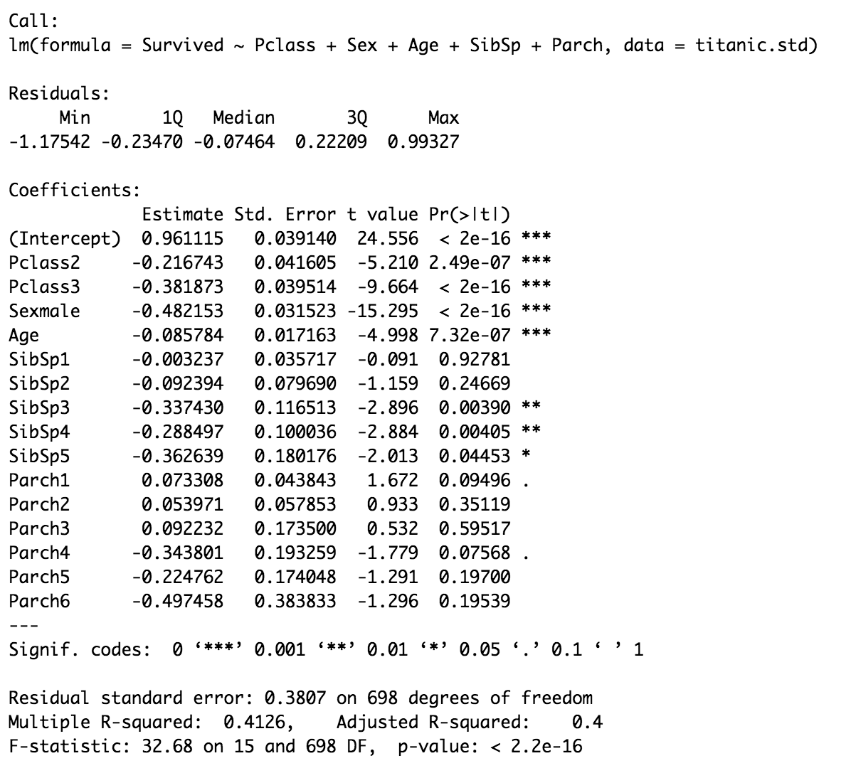
Multiple Linear Regression
Model 2
We removed Fare and Embarked variables
Adjusted R squared now improved to 0.4

Slide 18
Multiple Linear Regression
Model 2 Interpretation of significant variables:
Pclass2, Pclass3 have negative coefficients
-> People who stay on class 2 and 3 (more bottom of the ship) are more likely to die than people in higher class (class 1) which is also on top of the ship.
Sexmale has negative coefficient
-> Male passengers are more likely to die than females.
Age variable has a negative coefficient
-> The older the passenger, the more likely that they will die.
SipSp3, SipSp4, SipSp5 has negative coefficients
-> Those with more family members have a higher chance of dying.

Slide 19
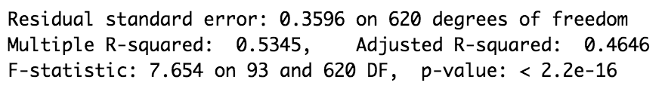
Multiple Linear Regression
Model 3
Add the interaction variables
The adjusted R squared is now higher at 0.4646
There are several pairs of variables that significantly affect the outcome of each other, such as:
Age:Parch1 and Age:Parch2: both have negative coefficients, meaning for those at the same age, those with 1 and 2 parent or children coming with them have higher death rate than those with more.
Pclass3:Fare: this pair has positive coefficient, meaning that for those at the lowest class, people who pay more will have higher survival chance
Age:Fare: has a similar trend as Pclass3:Fare

Slide 20
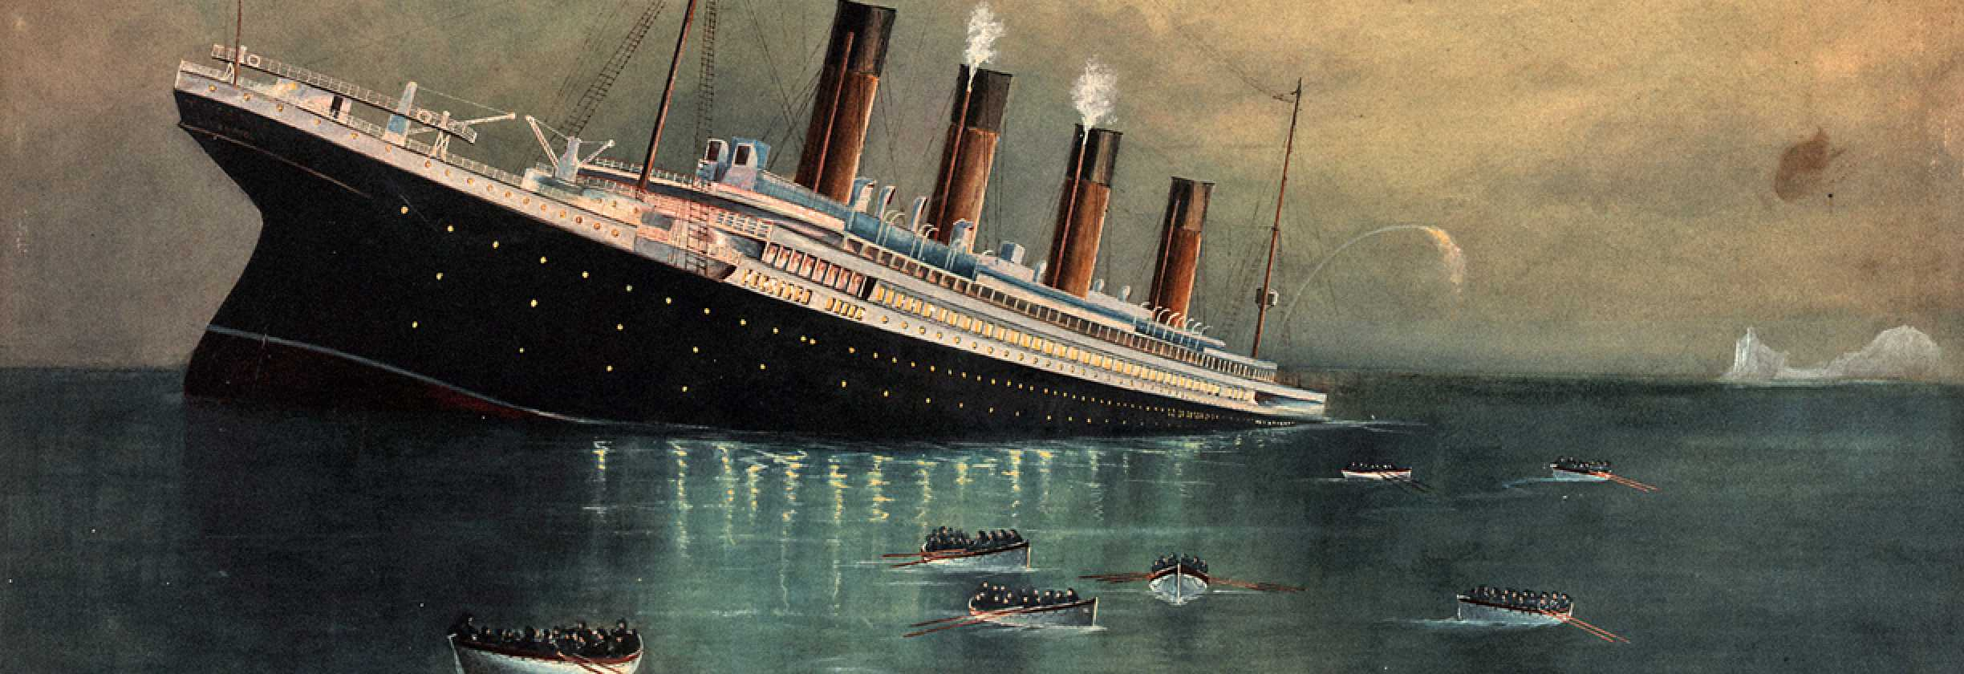
Results
Did not achieve a model with significant predictive power
highest Adj. R-Square value: 0.47

